Slide 1
Promoting Quality Child Outcomes Data
Donna Spiker, Lauren Barton, Cornelia Taylor, & Kathleen Hebbeler
ECO Center at SRI International
Presented at: International Society on Early Intervention (ISEI)
New York City, May 2011

Slide 2

What will be covered today
ENHANCE - Research underway on the validity of the Child Outcomes Summary Form Process (COS)
Need for ENHANCE
Considerations - building a validity argument
ENHANCE project and studies being conducted
2
Notes:
2

Slide 3
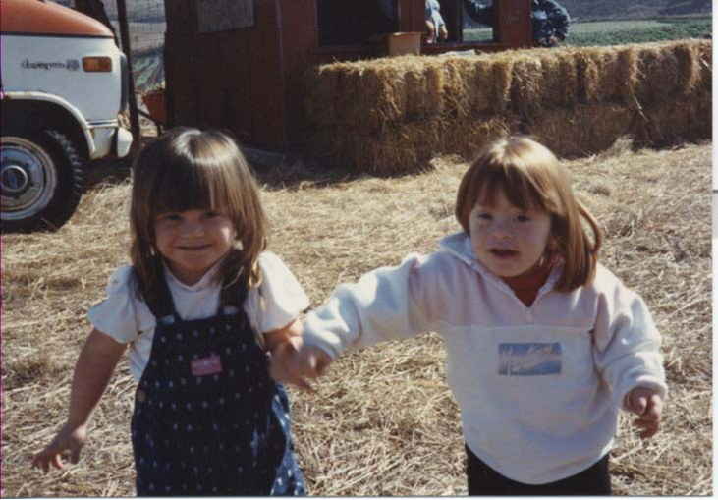
The need for:
High-quality child outcomes data for accountability
A way to measure
child outcomes in:
- young children
- children with
disabilities
3
Notes:
3

Slide 4
The need for an approach or tool that:
Captures multiple sources of information and child’s functioning across settings
Doesn’t require programs to change assessments
Relates to age-expected child functioning
Measures progress over time
Is inexpensive
Is ready to be implemented now
Is valid and reliable
4
Notes:
4

Slide 5
Child Outcome Summary Form Process (COS)
Captures multiple sources of information and child’s functioning across settings
Doesn’t require programs to change assessments
Relates to age-expected child functioning
Measures progress over time
Inexpensive
Already being implemented in many states
Valid and reliable
5
Notes:
5

Slide 6
What is the COS Process?
Not an assessment tool, but is a 7 point rating scale
Uses a team decision making process
Uses information from multiple assessment tools and observations to give global sense of child’s functioning at one point in time (e.g., for each of 3 OSEP outcomes)
Rating compares what child can do to typical functioning
6
Notes:
6

Slide 7
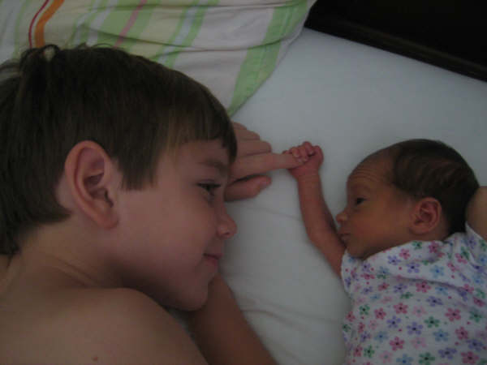
COS Process is in use in 49 of 59 states and jurisdictions, but…
More information is needed
  to document its reliability
  and validity,
  to improve guidance
  about the COSF process, and
  to inform appropriate use
  of the data we have.

Slide 8
ENHANCE
Project launched by the Early Childhood Outcomes Center (ECO) and SRI International
Funded by the U.S. Dept. of Education, Institute for Educational Sciences
Series of studies designed to find out:
  the conditions under which the COS process produces meaningful and useful data for accountability and program improvement.
  the positive and/or negative impact of the COS process on programs and staff.
  any needed revisions to the form and/or the process.

Slide 9


ENHANCE: Building & Testing a Validity Argument

Slide 10
Validity – What Are We Trying to Demonstrate?
Validity refers to the use of the information
Are you justified in reaching the conclusion you are reaching based on the data?
Standards for Educational and Psychological Testing(1999) by American Educational Research Association, American Psychological Association, National Council on Measurement in Education
10
Notes:
10

Slide 11
Validity Questions
The question is NOT “Are the data valid?”
The question is:
“Are the data for valid for the purpose of….?”
Are the data sufficiently trustworthy to lead to sound decisions?
  Examples: funding, TA, focused monitoring…
How much error is acceptable?
  There will be error…

Slide 12

Implications for COS Data
Validity is NOT a characteristic of an assessment or measurement device.
It is a characteristic of the data produced by the tool and how these data are used.
Implications: State A’s COSF data could be valid; State B’s COSF data could not be.

Slide 13
Implications for Studying Validity of COS Data in States
Under what conditions do states produce COS data that lead to valid conclusions?
  Requires studying:
  - states with varied COS implementation
  - if conclusions drawn from data are appropriate
Aim: Use findings to generate useful guidance for states
  How can states structure the COS process to produce valid data?

Slide 14

Validation Process
Validation process:
  Develop propositions (validity argument) - If data were valid for this use, then we would see….
  Collect evidence to examine those propositions in various locations with differences in implementation.

Slide 15
Examples of Propositions in the COS Validity Argument
Functioning (COS ratings) in one outcome area for most children is related to functioning in the other outcome areas.
Functioning (COS ratings) in an outcome area at time 1 is related to functioning in that area at a later point in time.
COS ratings will be related to the nature and severity of the child’s disability.
Distributions of COS ratings at entry will be similar across states serving similar populations and related to the percentage of children served in Part C or Part B Preschool.
Similar populations of children enter programs each year so functional levels (COS ratings) should remain constant without intervening factors (e.g., new state eligibility criteria).

Slide 16
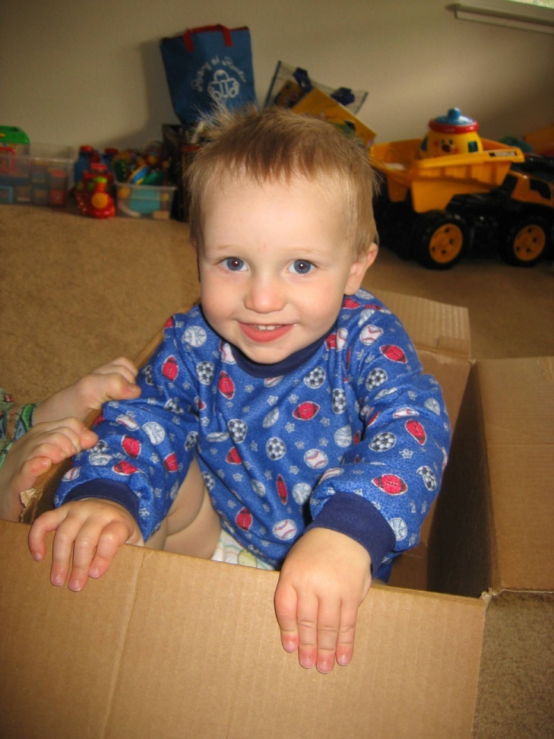
Four ENHANCE Studies
State data study
Comparison with child assessments study
Team decision-making study
Provider survey

Slide 17

State Data Study
Use extant data from states using COS on children birth-5 with disabilities served under IDEA
Analyze state level population data (within and across states) to examine characteristics of COS data and relationships to other variables
Sample is 12 (or more) states

Slide 18
States for 3 Other Studies
PART C EI - 6 states, 3 local programs in each
PART B Preschool - 6 states, 3 local programs in each
Total of 36 programs
States: IL, ME, MN, NM, NC, SC, TX

Slide 19

Comparison with Child
Assessments Study
Compare COS ratings and scores on 2 independently administered assessments (BDI-2 & Vineland II) at entry and at exit
Sample is 6 children at each site (216 total)
Notes:
19

Slide 20
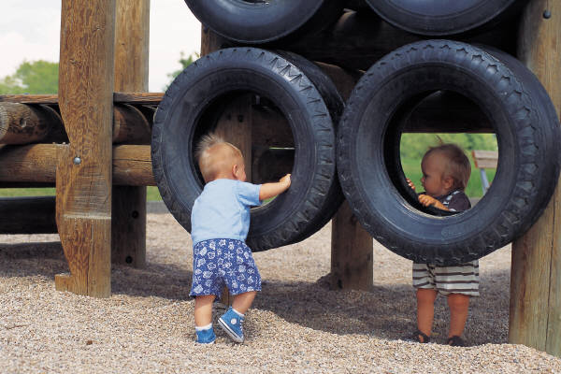
Team Decision-Making Study
Review videos of teams discussing and reaching consensus on COS ratings to understand how they use evidence and make ratings
Sample is 10 children at each site (360 total) (half entry and half exit COS meetings)
Notes:
Goals – learn about the COSF process

Slide 21

Provider Survey
Use a survey to gather information on providers’ knowledge of outcomes, COS criteria, age-expected behavior, their training on process, and impact on practice
Sample is all providers in program who participate in COS process

Slide 22


To find out more …..
ENHANCE Website
  http://ENHANCE.sri.com
ECO Center Website
  http://www.the-ECO-center.org
Contact ENHANCE staff
  E-mail: ENHANCE@sri.com
Notes:
22

